Slide 1
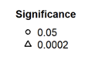
Ring porous
Diffuse porous
April T_{max}
#
#
+
#
#
SCBI
#
#
SCBI
Record number
#
#
HF
HF
-
1
#

